Slide 1

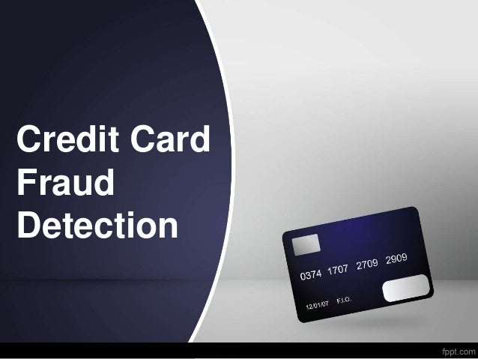
Credit Card Fraud Detection System
- Rahul Yadav

Slide 2
Agenda
Objective
Background
Key Insights
Cost Benefit Analysis
Appendix:
Data Attributes
Data Methodology

Slide 3
Objective
Getting in place a credit card fraud detection system to save on incurred costs.
Huge costs are being incurred due to frauds and a manual detection system.
Develop a machine learning model to detect fraudulent transactions based on the historical transaction data of customers with a pool of merchants.

Slide 4
Background
A machine learning model has been built to detect frauds early and mitigate losses
A cost benefit analysis has been done for the deployment of the same

Slide 5
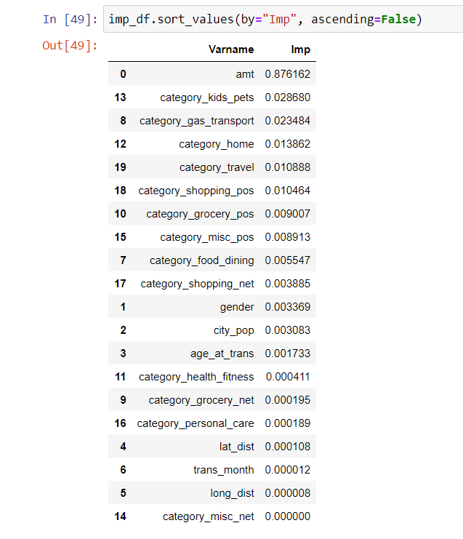
Key Insights
Transaction amount, category and gender are the most important variables
Gas and transport, grocery and shopping are the top three categories

Slide 6
Current Incurred Losses
77,183 credit card transaction per month.
402 fraudulent transaction per month.
$ 530.66 amount per fraud transaction
Total costs incurred from fraud transaction is $ 2,13,325.32

Slide 7
After New Model Deployment
 1720 fraudulent transactions detected by the model
 $ 1.5 cost to provide customer support to
these transactions that is $ 13105.5 in total
 27 fraudulent transactions not detected by model which amounts to $ 14327.82 loss
 Total cost incurred after new model deployment is $27433.32
 Final savings after new model deployment is $185892 that is reduction in losses by ~92%

Slide 8
Appendix: Data Attributes
 Snapshot of the data:
index - Unique Identifier for each row
transdatetrans_time - Transaction DateTime
cc_num - Credit Card Number of Customer
merchant - Merchant Name
category - Category of Merchant
amt - Amount of Transaction
first - First Name of Credit Card Holder
last - Last Name of Credit Card Holder
gender - Gender of Credit Card Holder
street - Street Address of Credit Card Holder
city - City of Credit Card Holder
state - State of Credit Card Holder
zip - Zip of Credit Card Holder
lat - Latitude Location of Credit Card Holder
long - Longitude Location of Credit Card Holder
city_pop - Credit Card Holder's City Population
job - Job of Credit Card Holder
dob - Date of Birth of Credit Card Holder
trans_num - Transaction Number
unix_time - UNIX Time of transaction
merch_lat - Latitude Location of Merchant
merch_long - Longitude Location of Merchant
is_fraud - Fraud Flag <--- Target Class

Slide 9
Appendix: Data Methodology
 Class imbalance adjusted using Adaptive Synthetic (ADASYN) sampling method
 Manual hyperparameter tuning done due to extensive computational times when using Grid Search Cross Validation

Slide 10


